Slide 1
Command Center
Shaowen Liu, Frank Shi, Fengsheng Shu, Scarlet Guo, Xuanxuan Ge

Slide 2
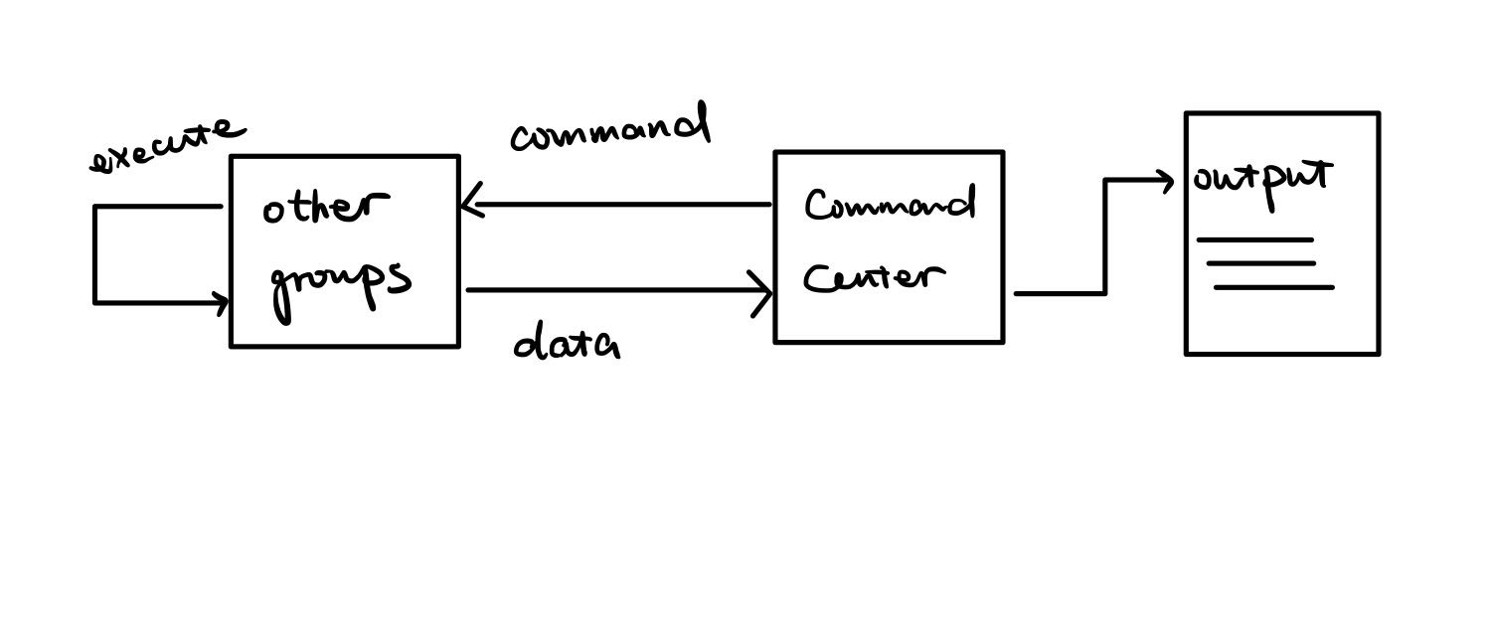
Function

Slide 3
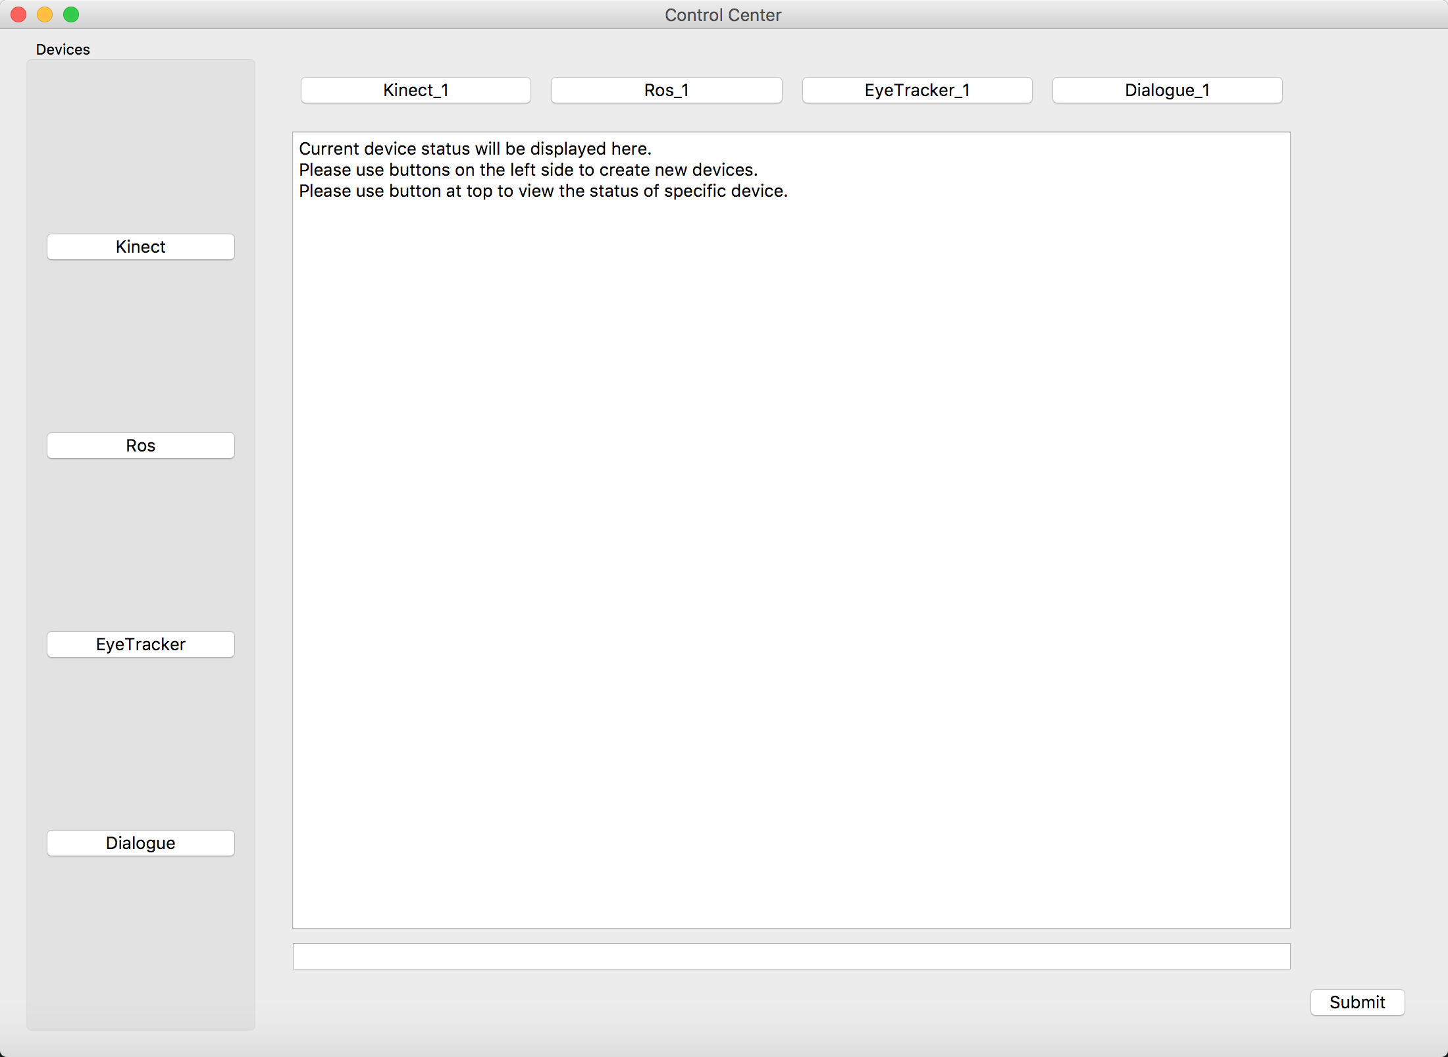
GUI Update
Create instances of each device added
Output information
Command line
Help Command

Slide 4
Demo
Collaborate with ROS group
Type command in GUI, output a file, the receiver from ROS group reads the command, Robot executes the command
Conflict check: exist of output file

Slide 5
Future Development
Get in touch with other groups
Send signal to call their function to start their program
Output different kinds of information in the GUI e.g. images

